Slide 1
Archana H. Deshpande
Assistant Professor
Newton’s Rings
Department of Basic Science & Humanities
Deogiri Institute of Engineering and Management Studies,
Aurangabad

Slide 2
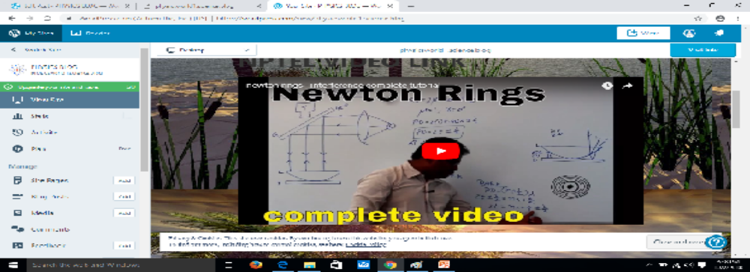
Reflection Spot
Reflection Spot :Timestamp(14:02min)
Reflection Spot ( AT 0.16 SEC)
At what angle the glass plate is inclined with the vertical axis of Microscope?
45 Degree
2

Slide 3
LbD Question
Q1.In Newton’s ring experiment the center is appear to be
a)Bright
b) Dark
c) Both
d) None of above
Ans: B
Q2 In Newton’s ring shape of interference pattern is
a) Circular fringes
b) Straight fringes
c) Bended fringes
d) Elliptical fringes
Ans:A

